Slide 1


The greatest songwriter of all time
MDB – Máster Data Science & Big Data
MIOTI - Tech & Business School
TABLE OF CONTENTS
PLAYLIST
01
Storytelling
02
Dataset
Components
03
Data Preprocessing
Espinosa Villanego Miguel
Mateos – Aparicio González Jorge
04
Models
05
Results & Conclusion
FP – Final Project
THANKS!
Mapreduce is obsolete
Alvaro Montero
0:00
8:00

Slide 2
Table of contents
Storytelling
Dataset
01
02
Models
Results & Conclusion
04
05
MDB – Máster Data Science & Big Data
Data Preprocessing
03
Who are we? What is our ambition?
Where did the dataset come from?
How a final dataset has been processed?
What Machine Learning algorithms have been used?
Have we achieved our goal?
Mapreduce is obsolete
Alvaro Montero
0:11
8:00

Slide 3
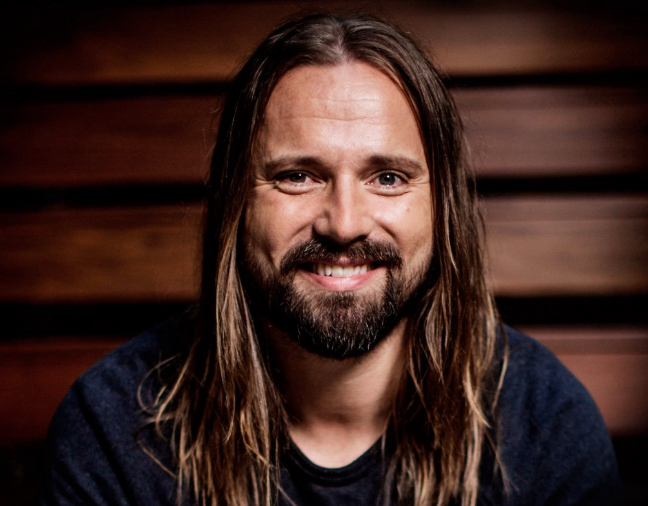
1. Storytelling
KARL MARTIN SANDBERG
(MAX MARTIN)
23 songs released as singles were became into No. 1 hits on the weekly Billboard Hot 100 chart
Map reduce is obsolete
Alvaro Montero
0:36
8:00

Slide 4
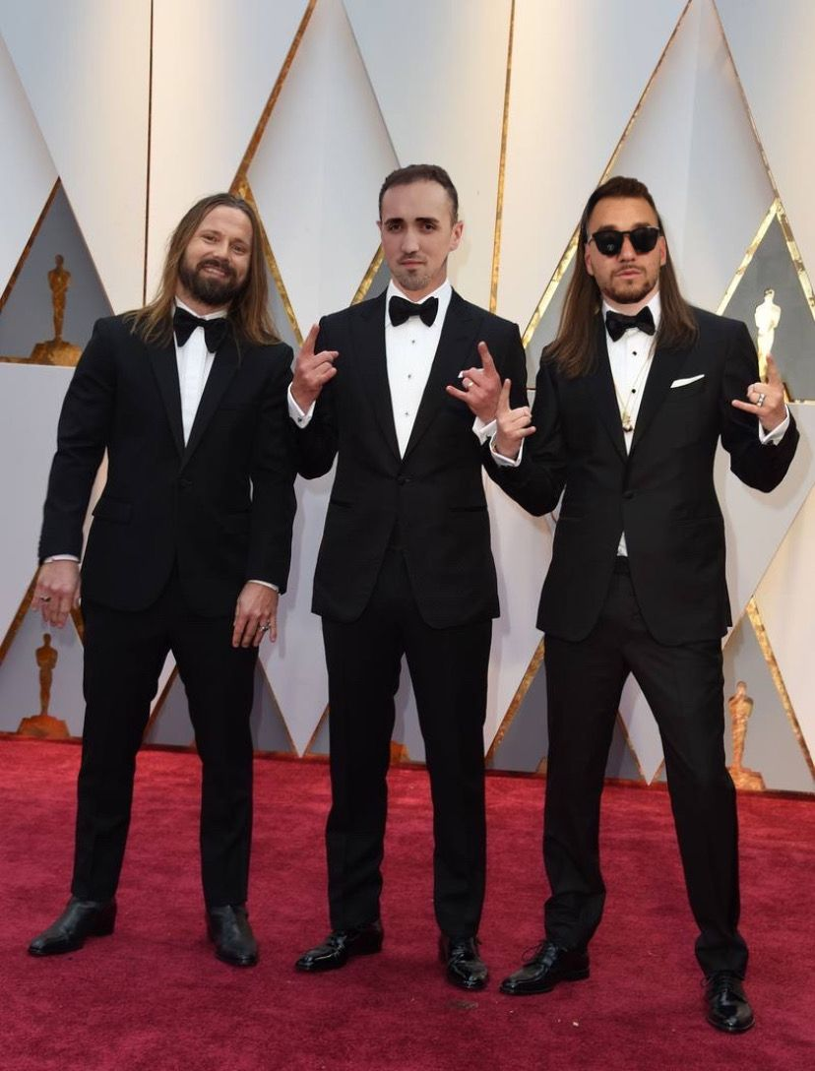


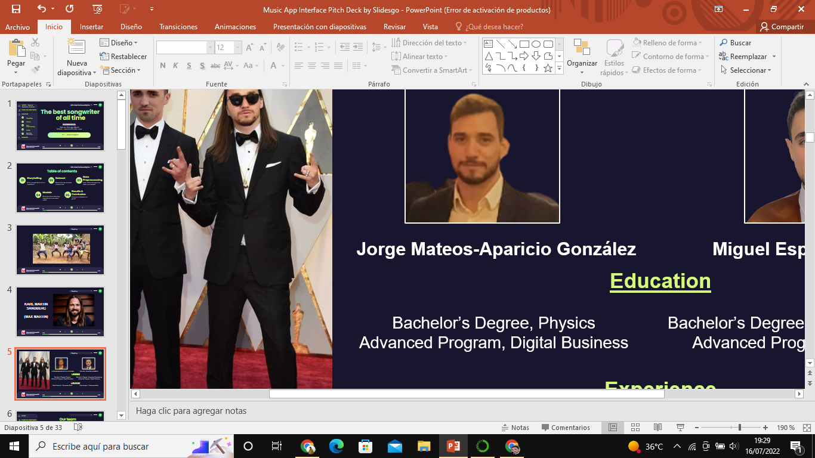
1. Storytelling
Jorge Mateos-Aparicio González
Miguel Espinosa Villanego
Education
Experience
Bachelor’s Degree, Physics
Advanced Program, Digital Business
Bachelor’s Degree, Aerospace Engineering
Advanced Program, Digital Business
Data Scientist – Santander Bank
Data Analyst – Santander Bank
Map reduce is obsolete
Alvaro Montero
0:43
8:00

Slide 5


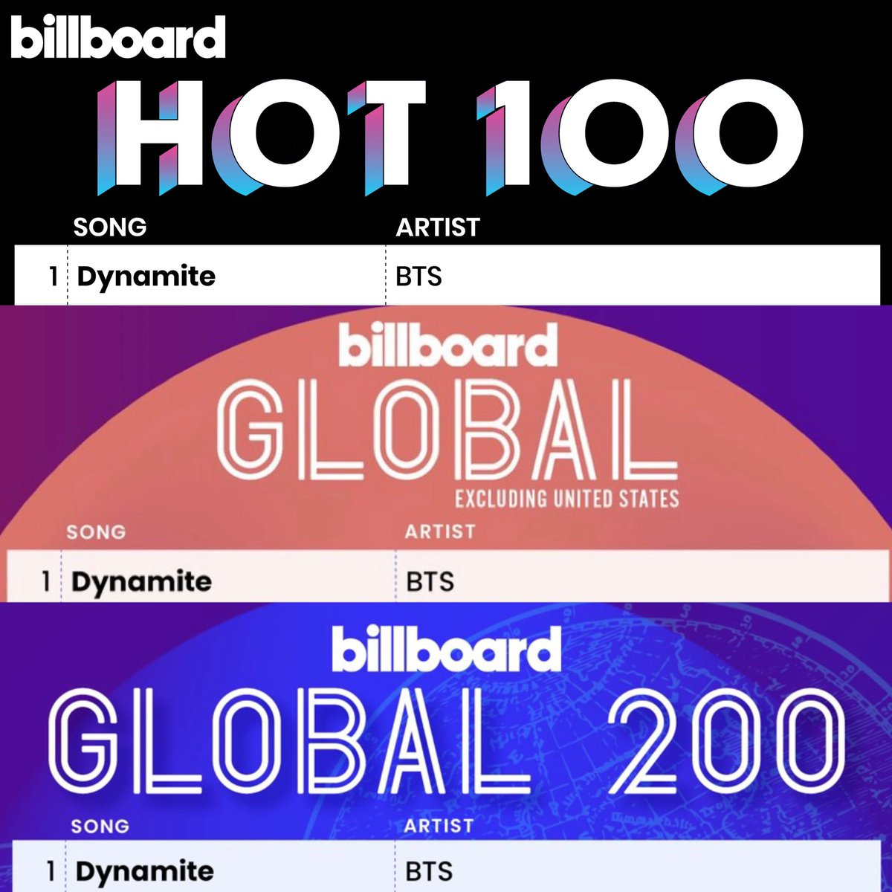
1. Storytelling
Through data science we will find the most relevant parameters when composing a song to make it a hit.
Could Max Martin be the greatest songwriter of all time?
Map reduce is obsolete
Alvaro Montero
1:09
8:00

Slide 6


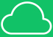



2. Dataset
How have we obtained the dataset?
Web API
Excel
Map reduce is obsolete
Alvaro Montero
1:26
8:00

Slide 7
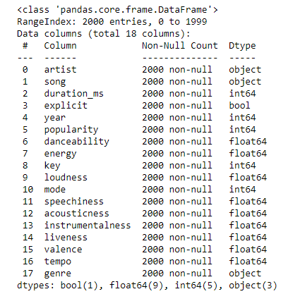
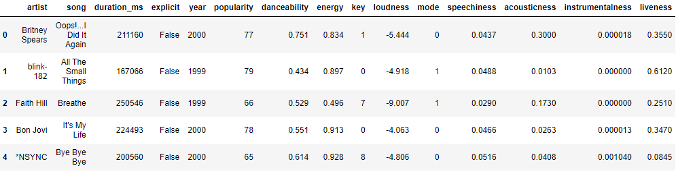
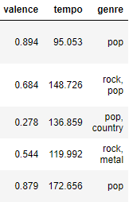
2. Dataset
Overview the dataset
Map reduce is obsolete
Alvaro Montero
1:50
8:00

Slide 8
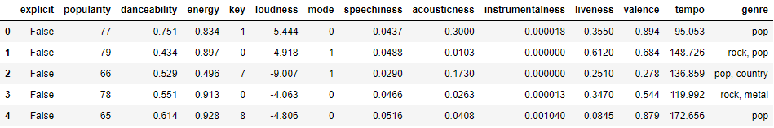
Dataset generation
3. Data preprocessing
EXPLICIT
The variable is Boolean, so we must present it in binary form:
Map reduce is obsolete
Alvaro Montero
2:03
8:00

Slide 9
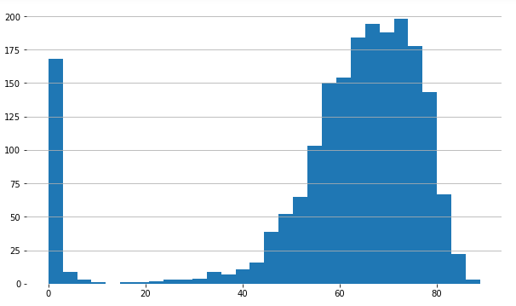
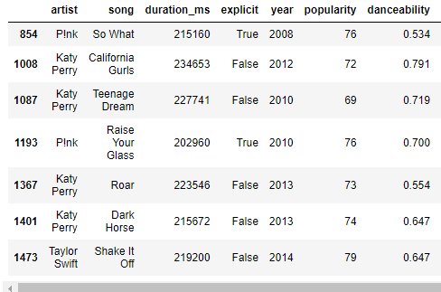
Dataset generation
3. Data preprocessing
POPULARITY
We see that the popularity needed to be a BillBoard top 100 is 74 (mean), but with about 71 we can already find a top 100
Map reduce is obsolete
Alvaro Montero
2:12
8:00

Slide 10
Dataset generation
3. Data preprocessing
DANCEABILITY
Map reduce is obsolete
Alvaro Montero
2:24
8:00

Slide 11
Dataset generation
3. Data preprocessing
ENERGY
Map reduce is obsolete
Alvaro Montero
2:27
8:00

Slide 12
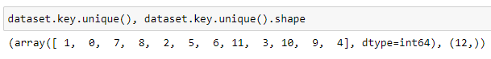
Dataset generation
3. Data preprocessing
KEY
The key parameter represents the key in which the song is written.
We see that we have twelve categories (as twelve are the chromatic notes)
Map reduce is obsolete
Alvaro Montero
2:30
8:00

Slide 13
Dataset generation
3. Data preprocessing
LOUDNESS
Map reduce is obsolete
Alvaro Montero
3:35
8:00

Slide 14
Dataset generation
3. Data preprocessing
MODE
Map reduce is obsolete
Alvaro Montero
4:11
8:00

Slide 15
Dataset generation
3. Data preprocessing
SPEECHINESS
Map reduce is obsolete
Alvaro Montero
4:14
8:00

Slide 16
Dataset generation
3. Data preprocessing
ACOUSTICNESS
Map reduce is obsolete
Alvaro Montero
4:18
8:00

Slide 17
Dataset generation
3. Data preprocessing
INSTRUMENTALNESS
Map reduce is obsolete
Alvaro Montero
6:03
8:00

Slide 18
Dataset generation
3. Data preprocessing
LIVENESS
Map reduce is obsolete
Alvaro Montero
6:05
8:00

Slide 19
Dataset generation
3. Data preprocessing
VALENCE
Map reduce is obsolete
Alvaro Montero
6:09
8:00

Slide 20
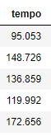
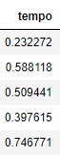
Dataset generation
3. Data preprocessing
TEMPO
Tempo represents the beats per minute of the song. It’s between 60 and 210 bpm, so this parameter can give excessive weight to the model: therefore we must typify it, in such a way that it has the same weight than the other variables:
Map reduce is obsolete
Alvaro Montero
6:10
8:00

Slide 21
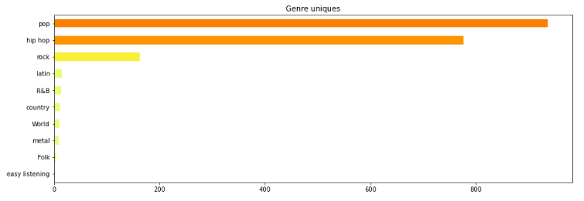
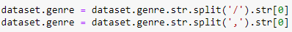
Dataset generation
3. Data preprocessing
GENRE
Given the number of different genres that we have, we are going to take only the first genre of the songs; by vectorizing string we can identify the separators and take only the first gender
Map reduce is obsolete
Alvaro Montero
6:18
8:00

Slide 22
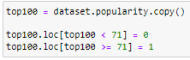
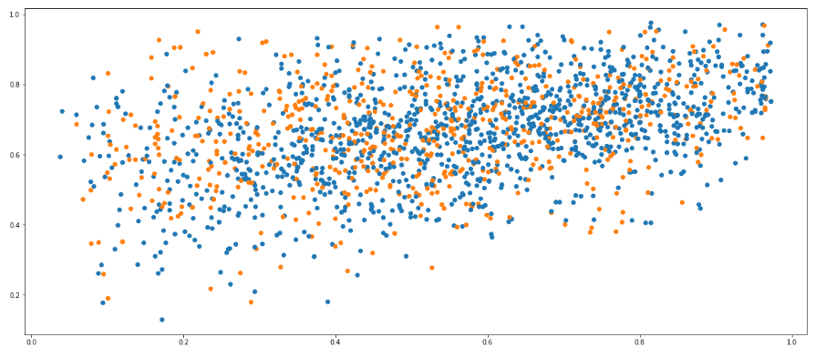
4. Models
667 samples (33.72% of the dataset)
1311 samples (66.28% of the dataset)
Unbalanced
Data Distribution
Map reduce is obsolete
Alvaro Montero
6:31
8:00

Slide 23
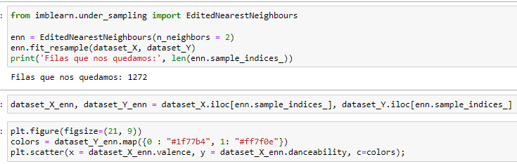
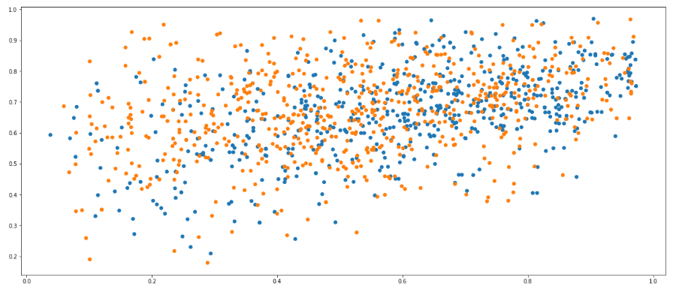
4. Models
667 samples (47.56 % of the dataset)
605 samples (52.44% of the dataset)
Balanced
New Data Distribution
Map reduce is obsolete
Alvaro Montero
6:40
8:00

Slide 24
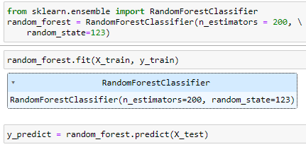
4. Models
We have a model that has a 70% chance of successfully classifying the hits.
Map reduce is obsolete
Alvaro Montero
6:48
8:00

Slide 25
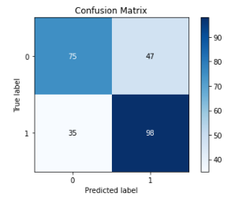
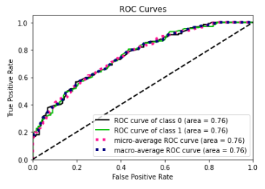
4. Models
Map reduce is obsolete
Alvaro Montero
6:59
8:00

Slide 26
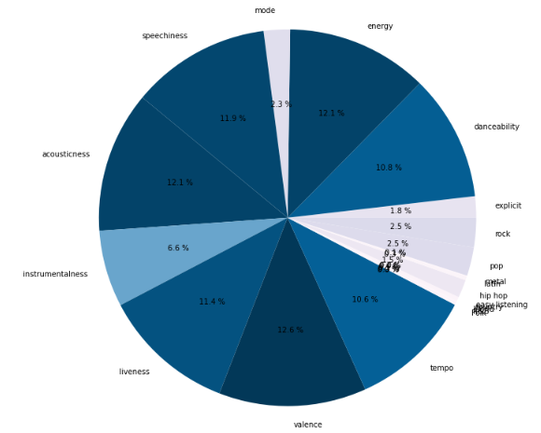
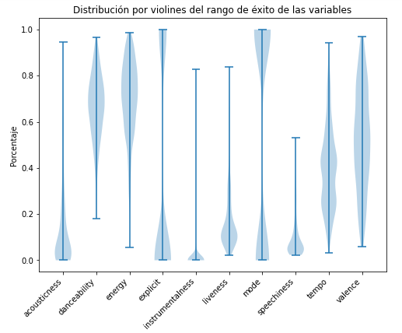
5. Results & Conclusion
Map reduce is obsolete
Alvaro Montero
7:34
8:00

Slide 27


A theme neither especially happy nor sad
That transmits some energy but not in excess
It's not acoustic, the voice predominates over the music and it must be an artificial sound, clearly from the studio
It's danceable
Doesn’t have purely instrumental sections
It’s in major mode and suitable for all audiences
Genre: It should be a pop or hip hop song, but never folk
Tempo: Should be around 120 bpm
Key: If possible, it must be written in A#
Decibels: About -5.3 DB decibels
All rights reserved

Slide 28
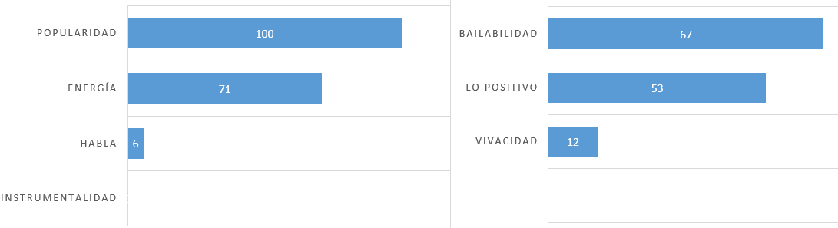


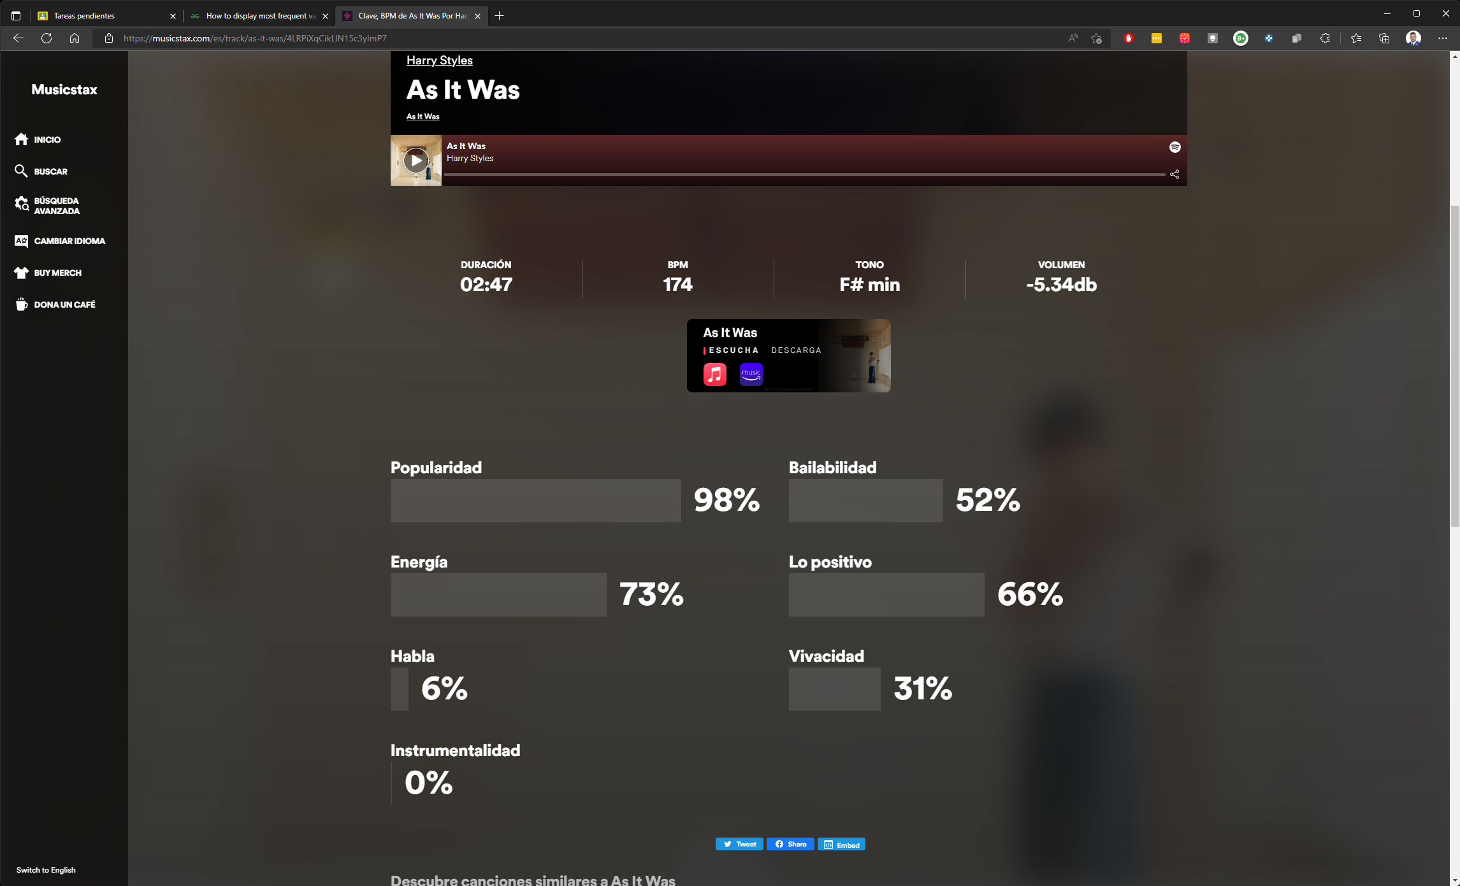
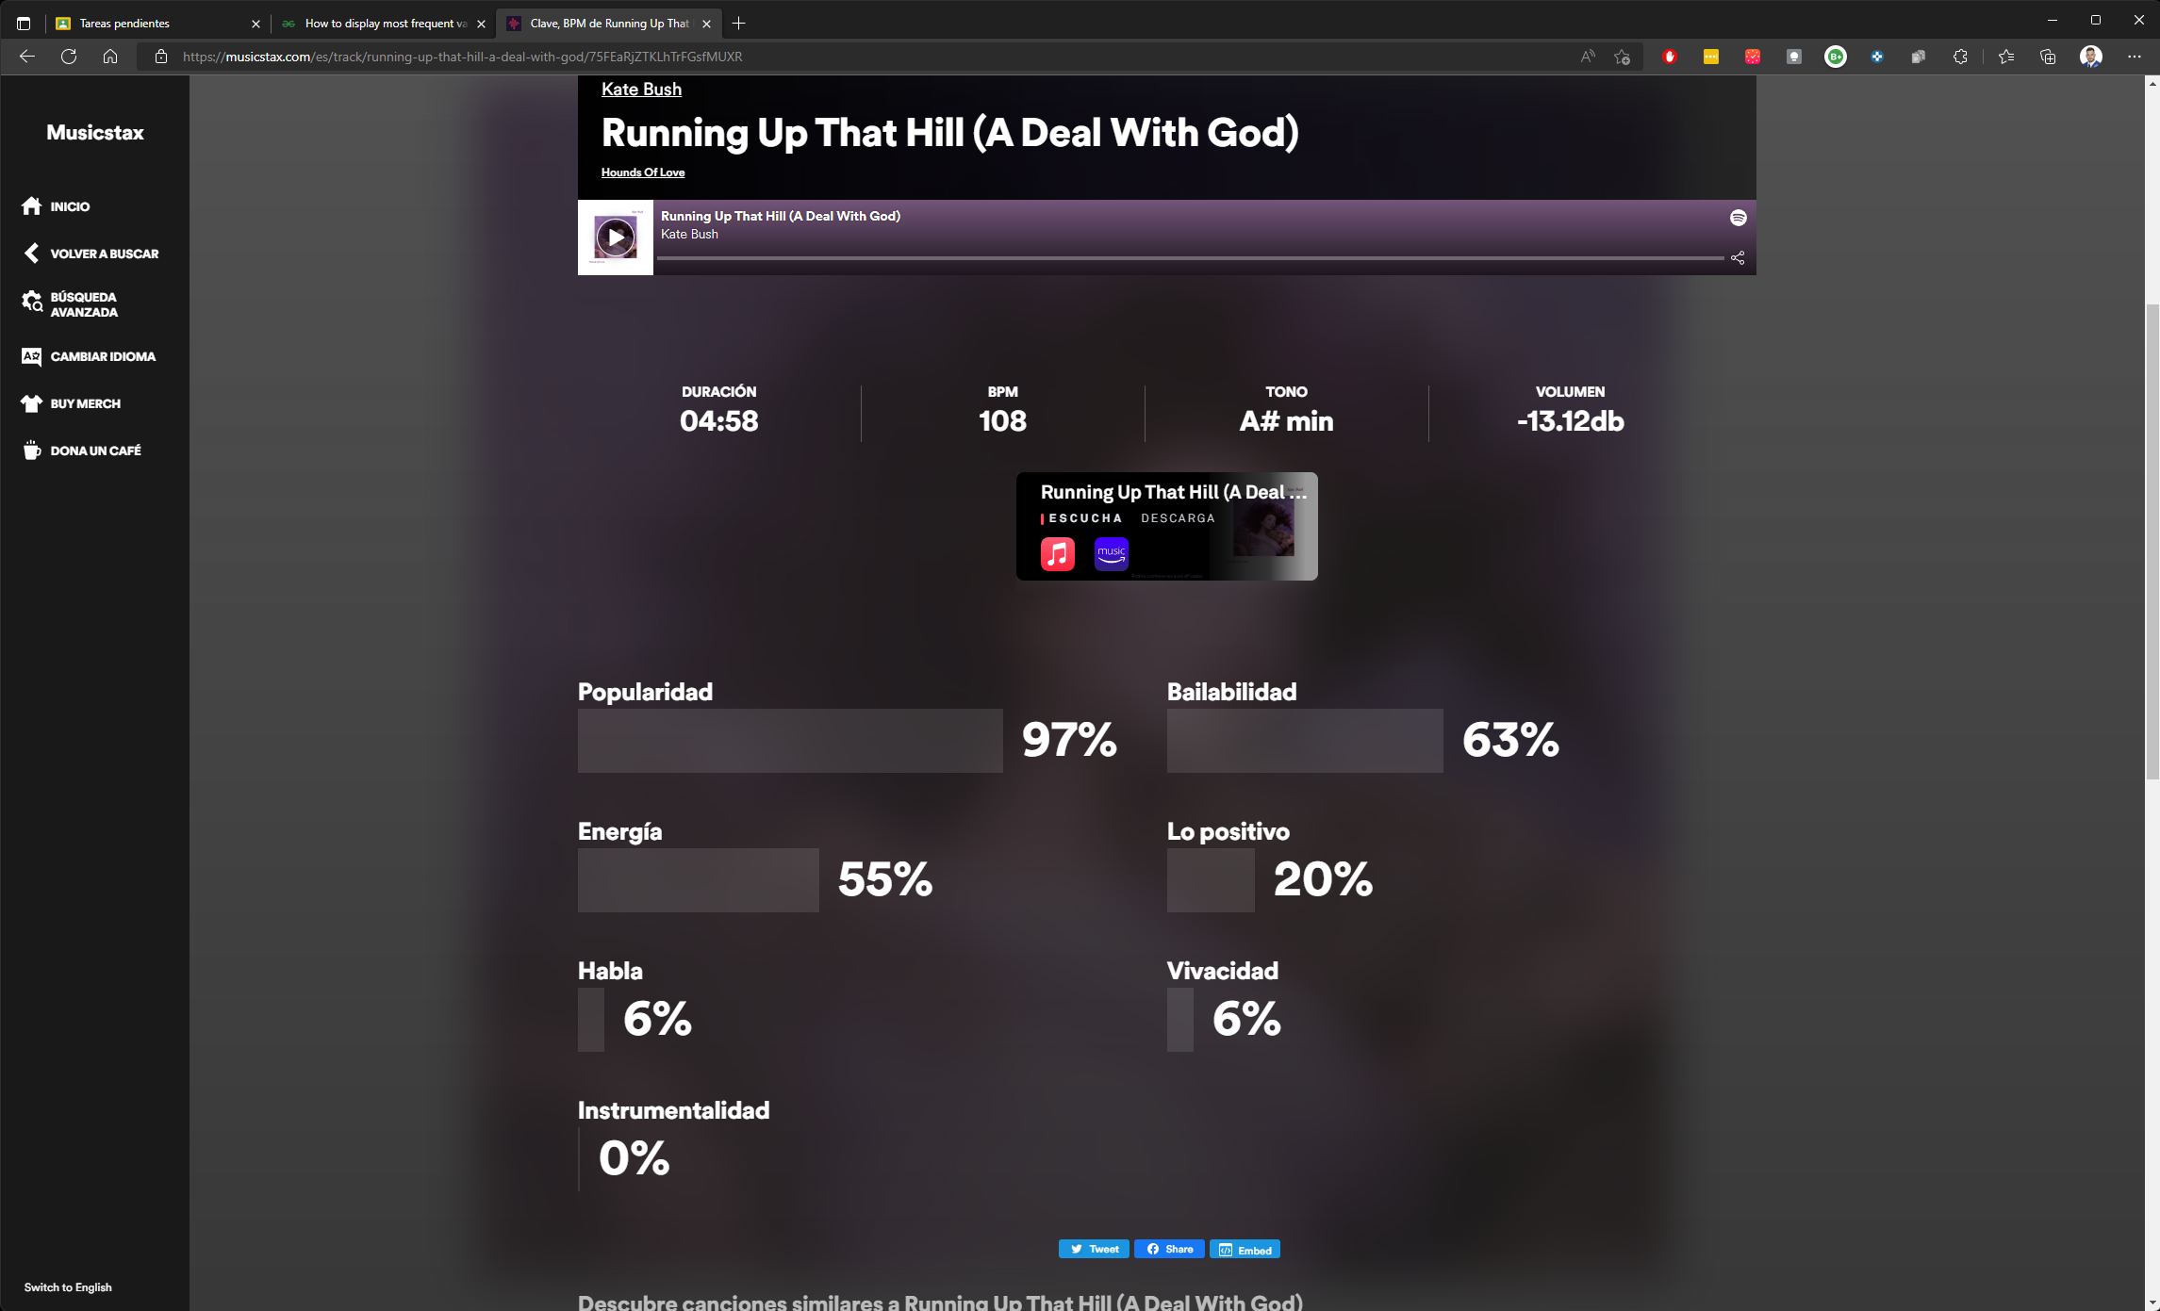
5. Results & Conclusion
Map reduce is obsolete
Alvaro Montero
7:43
8:00

Slide 29
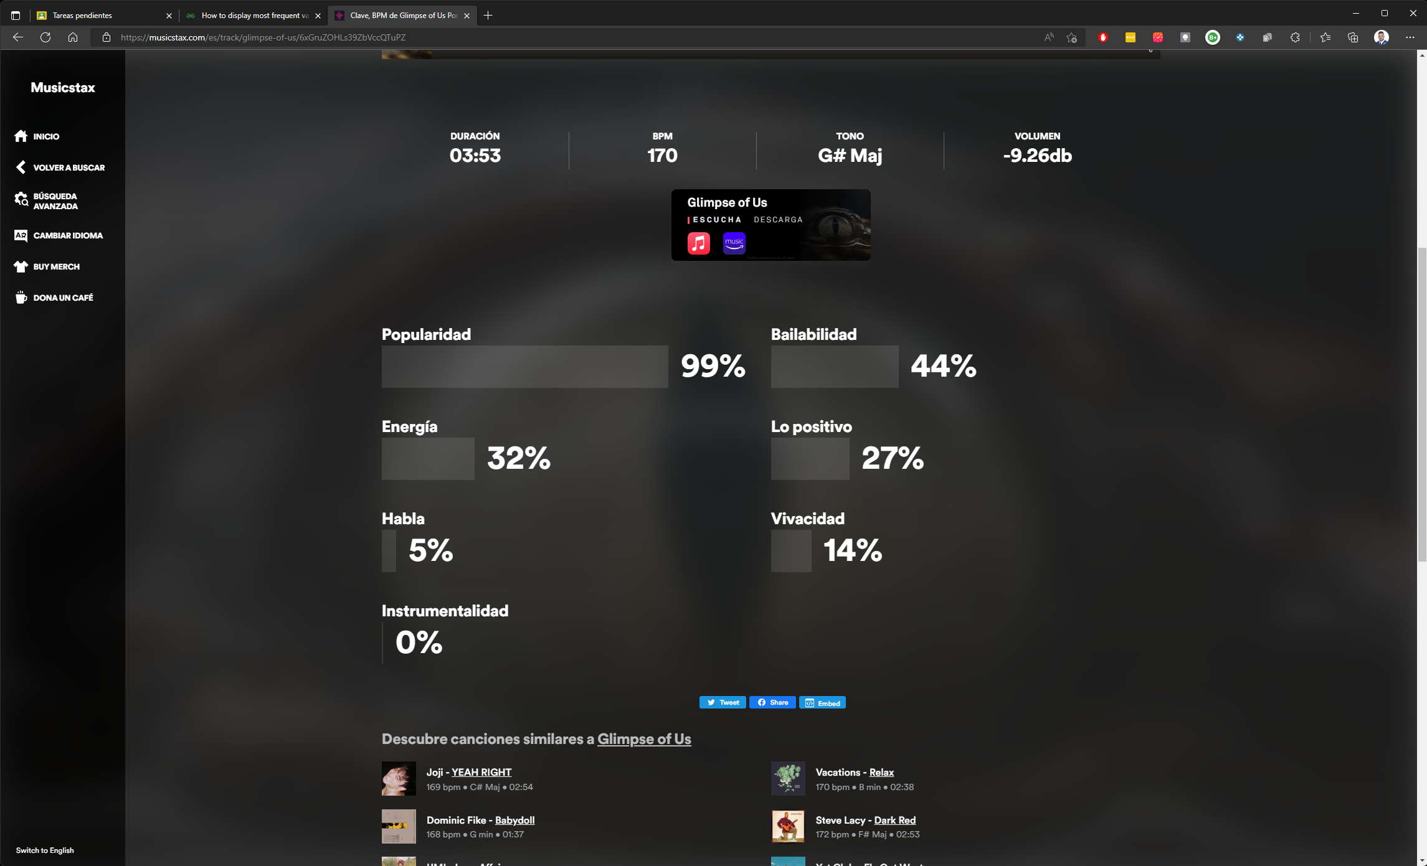
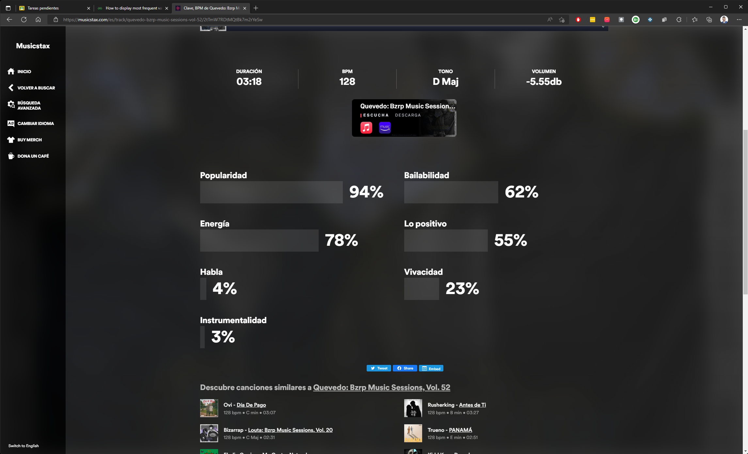
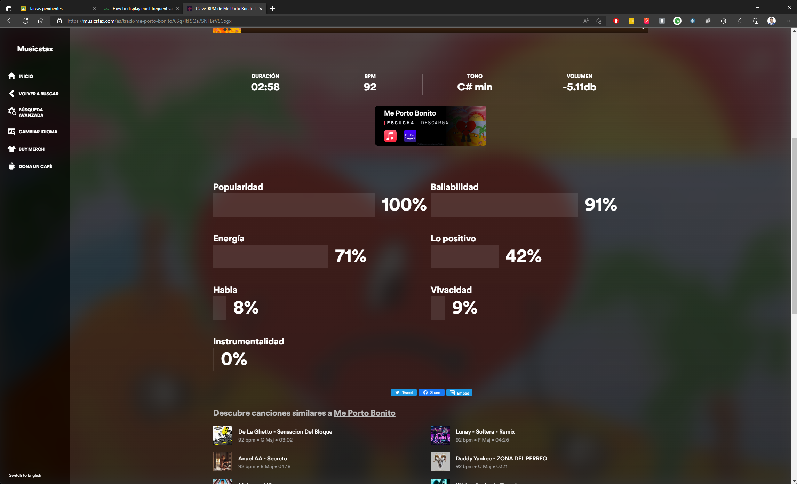
5. Results & Conclusion
Map reduce is obsolete
Alvaro Montero
7:52
8:00

Slide 30



Thanks!
MDB – Máster Data Science & Big Data
Now, Max Martin will be the greatest songwriter of all time!!!
Do you have any questions?
MIOTI - Tech & Business School
FP – Final Project
Please keep this slide for attribution
Map reduce is obsolete
Alvaro Montero
8:00
8:00

